Slide 1
SOA Approach in E-commerce Integration
UNDER THE GUIDANCE OF:
SATINNDER MAM
Presented by: DIVYA DHARSHINI.V

Slide 2
Introduction
This case study explores the implementation of a Service-Oriented Architecture (SOA) for an e-commerce platform. The goal is to integrate various systems such as online shops, warehouse management, financial management, couriers, and payment operators to create a seamless and efficient e-commerce solution.

Slide 3
Overview of the E-commerce Platform
The e-commerce platform consists of several key components:
Online Shop: Interface for customers to browse and purchase products.
Warehouse Management System (WMS): Manages inventory and order fulfillment.
Financial Management System: Handles billing, payments, and financial records.
Courier Systems: Manages the delivery of products to customers.
Online Payment Operators: Processes online payments.
Enterprise Resource Planning (ERP): Integrates various business processes and synchronizes data across systems.

Slide 4
SOA Layers
The SOA implementation is divided into several layers:
Policy and Business Processes Layer: Defines business rules and workflows.
Service Layer: Provides reusable services for different business functions.
Service Description Layer: Documents the services and their interfaces.
Service Communication Protocol Layer: Handles the communication between services using APIs.
Transport Layer: Manages the network communication protocols.

Slide 5
System Integration Flow
The integration flow involves the interaction between the systems to handle various e-commerce processes such as order processing, payment, and delivery.

Slide 6
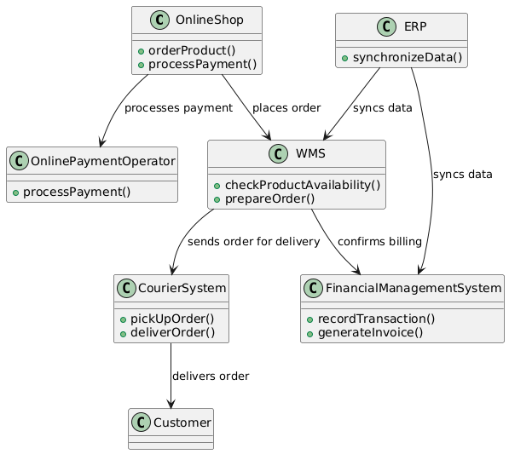
UML Diagrams
Class diagram:

Slide 7
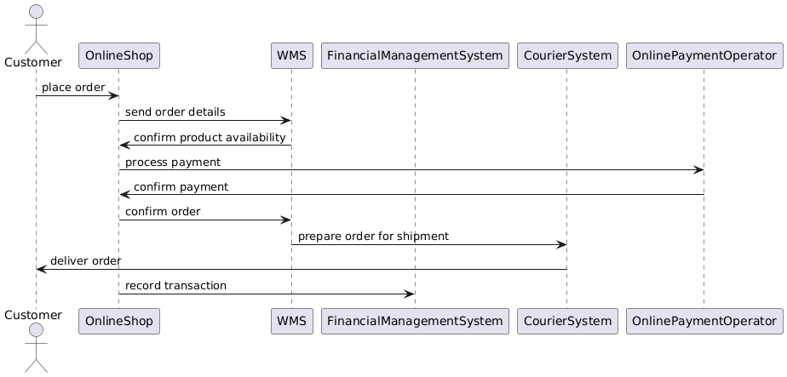
Sequential diagram

Slide 8
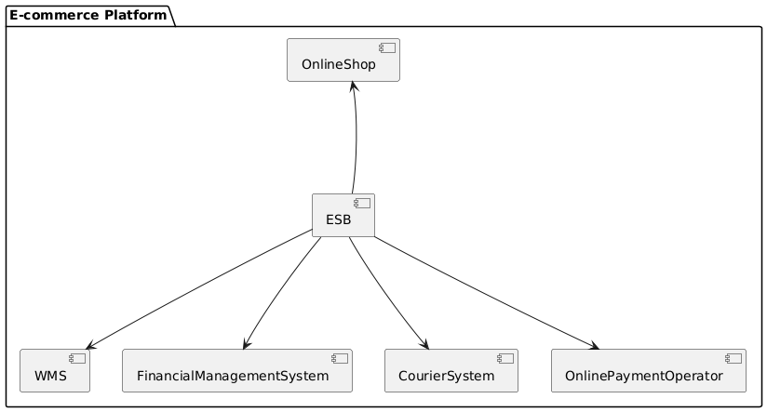
Component diagram:

Slide 9
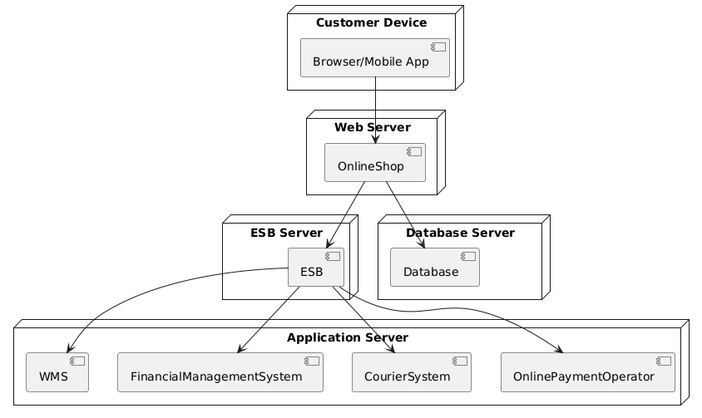
Deployment diagram:

Slide 10
Implementation Details
Online Shop: The front-end web application where customers can browse products, add them to the cart, and place orders. It interacts with the WMS to check product availability and with the Online Payment Operator to process payments.
WMS: Manages inventory and handles order fulfillment. It communicates with the Financial Management System to confirm billing and the Courier System to arrange delivery.
Financial Management System: Keeps track of all financial transactions, including payments and invoices. It ensures that all transactions are recorded and invoices are generated as needed.

Slide 11
Courier Systems: Integrates with various courier services to manage the delivery of products. It ensures that orders are picked up and delivered to customers efficiently.
Online Payment Operators: Handles the processing of online payments. It ensures secure and reliable payment processing for orders.
ERP: Synchronizes data between different systems, ensuring consistency and accuracy across the platform.

Slide 12
Benefits of SOA in E-commerce Integration
Scalability: Services can be scaled independently based on demand.
Reusability: Services are designed to be reusable across different applications.
Maintainability: Easier to update and maintain individual services without affecting the entire system.
Interoperability: Different systems can communicate effectively using standardized APIs.

Slide 13
Conclusion:
Implementing an SOA approach in e-commerce integration enhances the flexibility, scalability, and maintainability of the platform. By utilizing a service-oriented architecture, the e-commerce platform can efficiently handle various business processes and adapt to changing business needs. The provided UML diagrams offer a visual representation of the system architecture and interactions, aiding in the understanding and development of the platform.

Slide 14
Thank you

